Slide 1
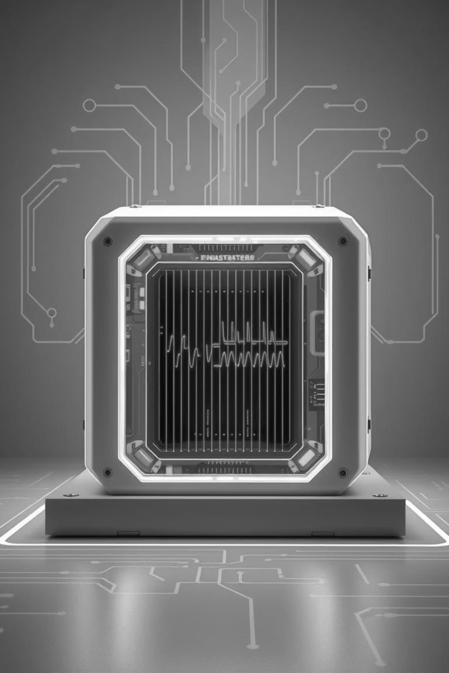
A
PRESENTATION ON
‘EMI MODELING IN HIGH-SPEED POWER CONVERTERS’
Presented by : Mr. Kartik L. Shelke
Guide : Dr. Manas R. Sial

Slide 2
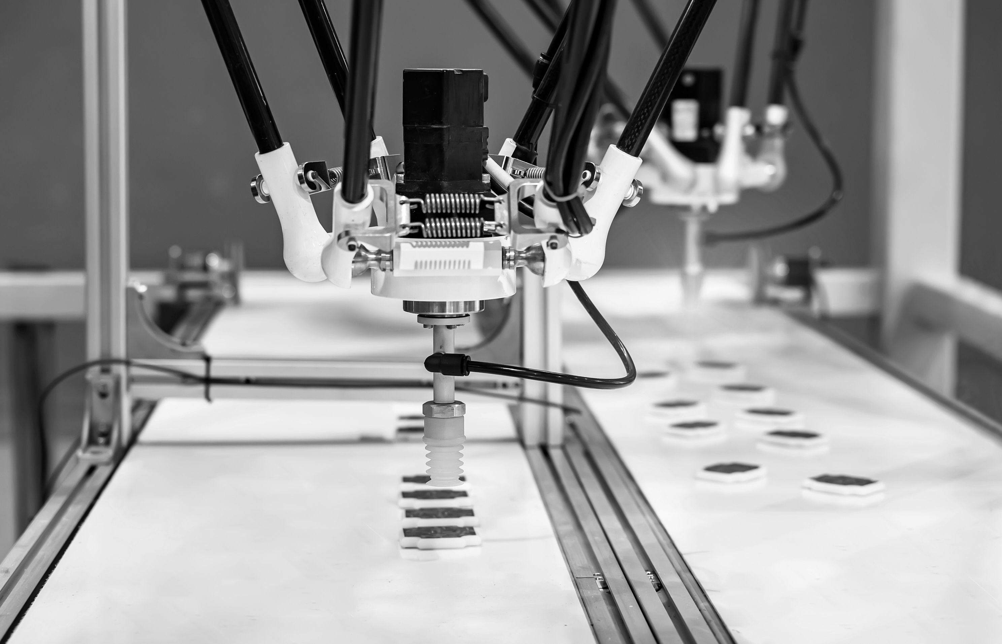
MOTIVATION
•High-speed switching → increased EMI
•Disrupts nearby systems and violates EMC standards
•Essential to model EMI early for design and compliance

Slide 3
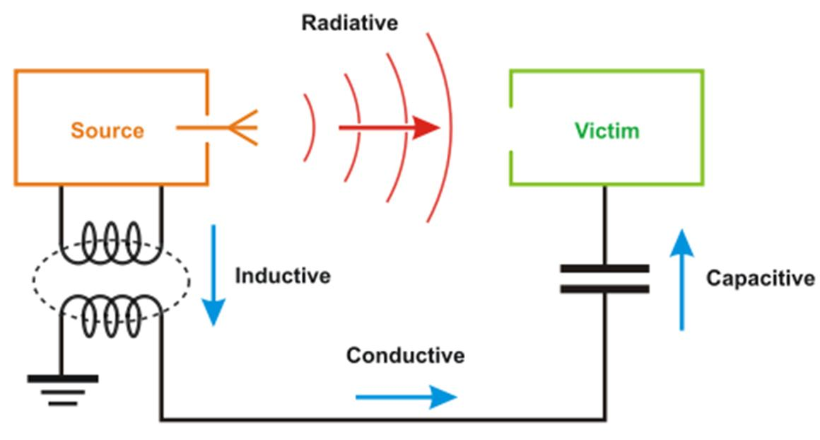
WHAT IS EMI?
Electromagnetic Interference (EMI): unwanted noise from switching devices
Caused by high dv/dt, di/dt, parasitics, and fast switching devices (SiC, GaN)

Slide 4
TYPES OF EMI
01
02
Conducted EMI: Travels through power lines
Radiated EMI: Travels through air
Has Common-Mode (CM) and Differential-Mode (DM) components

Slide 5

KEY EMI SOURCES
Switching Devices (MOSFETs, IGBTs)
• Gate Drivers
• Transformers (leakage, coupling)
• PCB layout (trace antennas)

Slide 6
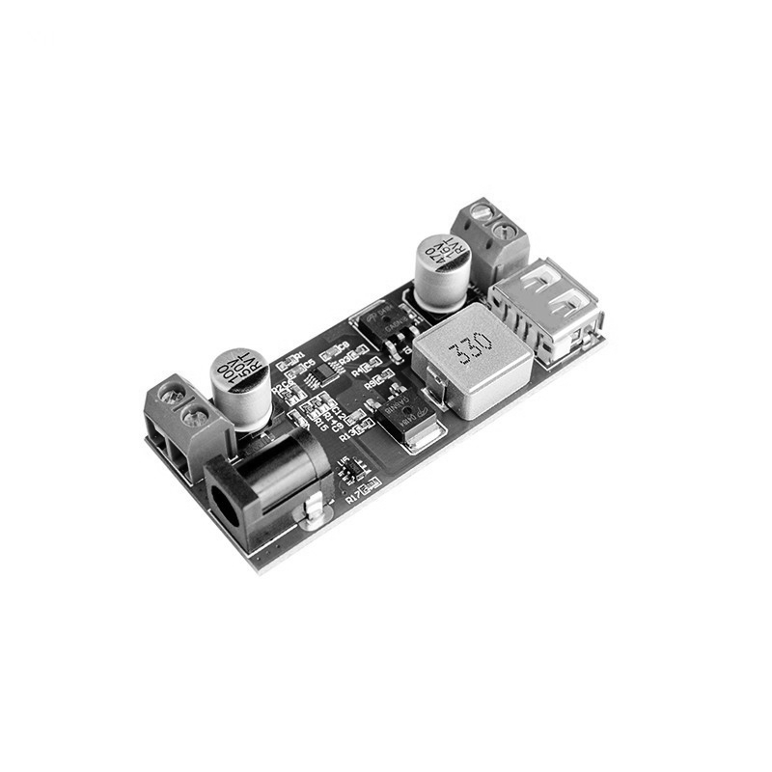
WHAT IS POWER CONVERSION?
Power conversion refers to the process of changing electrical energy from one form to another.
Common types:
AC to DC (Rectifiers)
DC to DC (Converters)
DC to AC (Inverters)
AC to AC (Cycloconverters)

Slide 7
WHY BUCK CONVERTER?
The Buck Converter is a step-down DC-DC converter that reduces the input voltage to a lower, regulated output voltage.
It is widely used in:
EV power supplies
Embedded systems
Battery chargers
EMI-sensitive applications

Slide 8
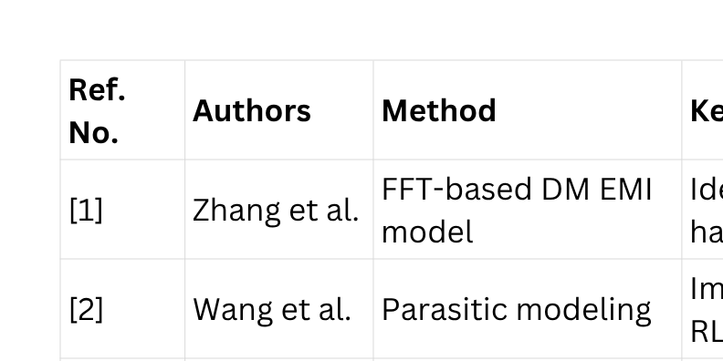
LITERATURE SURVEY

Slide 9

RESEARCH GAP

Slide 10
PROPOSED WORK
To develop a comprehensive EMI modeling framework for high-speed buck converters by incorporating both common-mode and differential-mode interference paths using realistic parasitic components, and to design and simulate effective EMI filters in MATLAB/Simulink for compliance with EMI standards.

Slide 11

OBJECTIVES
Model EMI in buck converters
Simulate in time and frequency domain
Propose filtering and mitigation techniques

Slide 12
METHODOLOGY
Select topology and parameters
Model parasitic elements
Simulate in Simulink
Use FFT for EMI spectrum
Apply filters and compare results

Slide 13
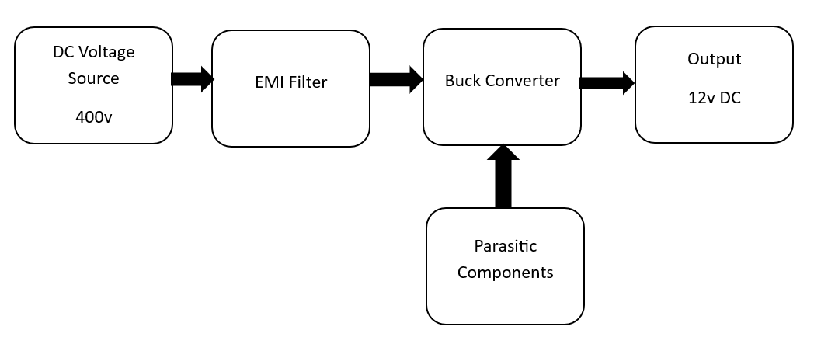
BLOCK DIAGRAM

Slide 14
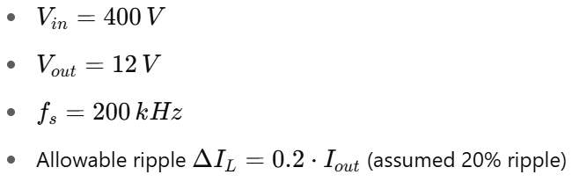
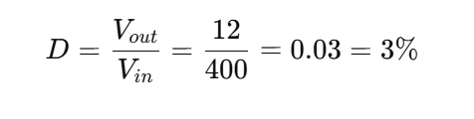
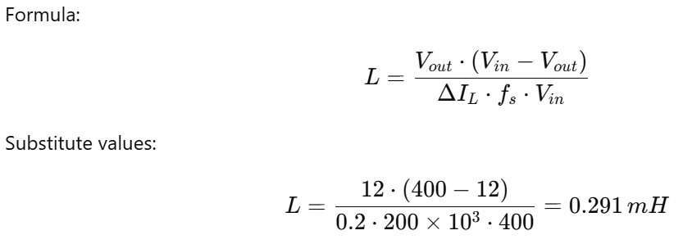
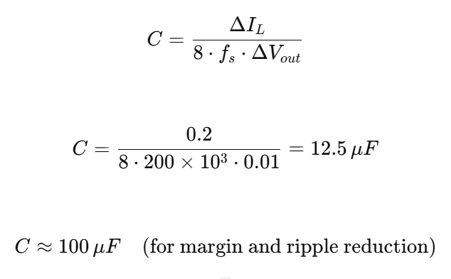
MATHEMATICAL MODELING—CONVERTER
Duty Cycle
3. Capacitor Value
2. Inductor Value

Slide 15

MATHEMATICAL MODELING – EMI
VDM = (V+) - (V-)
VCM = ((V+) + (V-)) / 2
Use FFT: X(f) = ∫x(t)e^(-j2πft)dt

Slide 16
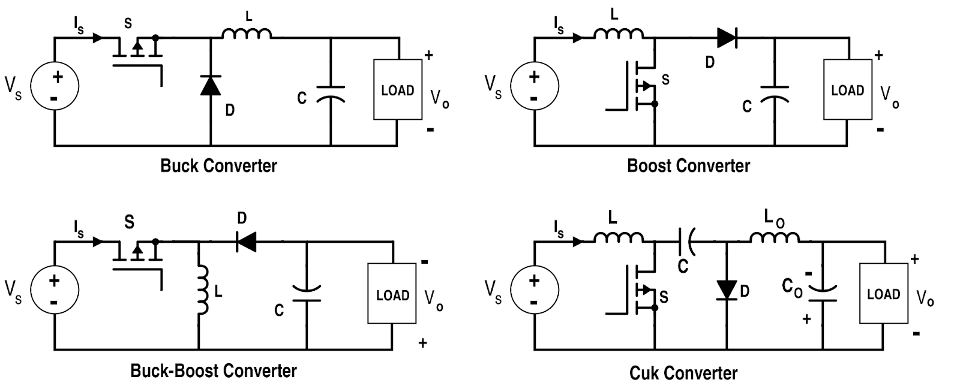
CONVERTER WITHOUT PARACITICS

Slide 17
SIMULATION OUTPUT

Slide 18
CONVERTER WITH PARASITICS

Slide 19
SIMULATION OUTPUT

Slide 20
EMI MITIGATION TECHNIQUES
Source: Soft switching, snubbers
Layout: Minimize loop area
Filtering: X/Y caps, CM chokes
Shielding: Ferrite beads, metal casing

Slide 21
CONCLUSION
In this phase of the project, a buck converter has been successfully designed with the inclusion of key parasitic components such as trace inductance and stray capacitance. This has enabled a more realistic modeling of EMI behavior in high-speed switching conditions. Initial simulations reflect the presence of EMI noise, particularly at switching transitions. Work is currently in progress to design and analyze suitable EMI filters to mitigate both common-mode and differential-mode interference. The next phase will focus on optimizing these filters and evaluating EMI performance in both time and frequency domains.

Slide 22
REFFERENCES
1. Biju, "Design of Controllers for DC-DC Buck Converters," J. Earth Environ. Sci. Res., pp. 1–9, 2025, doi: 10.47363/JEESR/2025(7)246.
2. O. T. Altınöz, "Design and Analysis of the Cascaded and Parallel Connected Buck and Boost Converter," 2025.
3. J. Park et al., "Modeling and Analysis of High Speed Switching Buck Converter IC for Conducted Emission Estimation," EMC EUROPE, Rome, 2020, pp. 1–4, doi: 10.1109/EMCEUROPE48519.2020.9245679.
4. N. Zhang, D. Li, V. Zhang, and A. Chen, "Reduce Conducted EMI in Automotive Buck Converter Applications," IEEE SPEEDAM, 2019, pp. 1212–1217.
5. D. R. A. Shirley et al., "EMI Characterization in Power Converters," J. Phys.: Conf. Ser., vol. 2325, 012014, 2022, doi: 10.1088/1742-6596/2325/1/012014.
6. S. Xu et al., "A Review on Conductive EMI Suppression Methods in High-Frequency Power Converters," IET Power Electron., vol. 15, pp. 1921–1935, 2022, doi: 10.1049/pel2.12348.
7. X. Wu et al., "Advances in Modeling and Suppression of EMI in Power Converters," Electronics, vol. 12, p. 2348, 2023, doi: 10.3390/electronics12112348.
8. X. Chen et al., "Common-Mode EMI Modeling Based on Inductive Coupling in SiC Power Modules," IEEE Trans. Power Electron., vol. 36, no. 6, pp. 6644–6661, 2021, doi: 10.1109/TPEL.2020.3046658.
9. L. Pace et al., "Parasitic Loop Inductance Reduction in GaN-Based Converters Using EM Simulations," Energies, vol. 14, p. 1495, 2021, doi: 10.3390/en14051495.
10. Seng et al., "High-Frequency Equivalent Circuit Model for CM Noise of Buck Converter," ICEMS, Korea, 2021, pp. 228–231, doi: 10.23919/ICEMS52562.2021.9634528.

Slide 23
REFFERENCES
11. Y. Liang et al., "EMI Challenges in Modern Power Converters," Front. Electronics, vol. 4, 2023.
12. H. Song and D. Boroyevich, "Noise on Gate Driver Traces in SiC-Based Converters," EMC+SIPI, MI, 2023, pp. 585–590, doi: 10.1109/EMCSIPI50001.2023.10241729.
A. Farhadi, "Conducted EMI Reduction in PWM Buck Converter," ICHQP, 2008, pp. 1–6, doi: 10.1109/ICHQP.2008.4668755.
13. K. Wang et al., "High-Voltage Electric Drive Modeling for EMI in EVs," IEEE Trans. Transport. Electr., vol. 9, no. 2, pp. 2808–2819, 2023, doi: 10.1109/TTE.2022.3224541.
14. F. Li et al., "Design of Hybrid EMI Filter for DC-DC Converter with SiC," ACEEE, China, 2023, pp. 46–50, doi: 10.1109/ACEEE58657.2023.10239563.
15. J. Kundrata et al., "Co-Optimization of EMI and Ripple in Buck Converters," IEEE Access, vol. 10, pp. 131909–131919, 2022, doi: 10.1109/ACCESS.2022.3229972.
16. Z. Qing et al., "CM EMI Reduction via Balance Technique in DC–AC Converters," IEEE Trans. Power Electron., vol. 39, no. 11, pp. 14318–14329, 2024, doi: 10.1109/TPEL.2024.3429165.
17. M. Darisi et al., "Digital Active EMI Filter for Smart Converters," Electronics, vol. 13, p. 3889, 2024, doi: 10.3390/electronics13193889.
18. F. A. Kharanaq et al., "State-of-the-Art EMI Modeling in Converters," IEEE Access, vol. 8, pp. 189313–189325, 2020, doi: 10.1109/ACCESS.2020.3031693.
19. M. Csizmadia and M. Kuczmann, "Feedback Linearization Control of Buck Converter," GPMC, pp. 35–38, 2020, doi: 10.1109/GPMC50267.2020.9333821.
20. Y. Zhang and S. Wang, "Design of Filter Components to Suppress Radiated EMI," IPEC-Himeji, Japan, 2022, pp. 1082–1089, doi: 10.23919/IPEC-Himeji2022-ECCE53331.2022.9807145.
21. S. Luo et al., "Modeling and Suppression of CM Conducted EMI in Multi-Converter Systems," IEEE Trans. Ind. Electron., 2025, doi: 10.1109/TIE.2025.3536559.
22. ResearchGate, "Modeling and Reduction of Radiated EMI in Automotive Converters," [Online]. Available: https://www.researchgate.net/publication/341477108_Modeling_and_Reduction_of_Radiated_EMI_in_Non-isolated_Power_Converters_in_Automotive_Applications

Slide 24

THANK YOU

